Slide 1
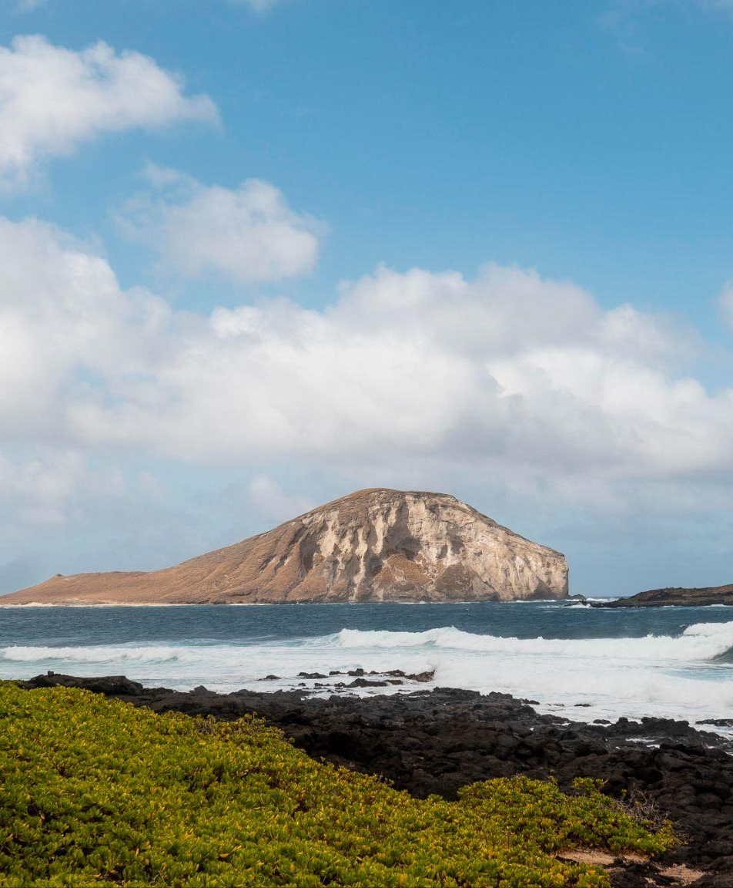
VISIT Safirni
Safirni it’s travling website

Slide 2
TABLE OF CONTENTS
01
02
03
04
05
06
About safirni
Our goals
Home
What’s Safirni is
What we expect safirni to do
Describe the topic
of the section here
About us
countries
Login and reg

Slide 3


OUR COMPANY
We strive to provide advice on how to plan trips in an efficient way and also get the best offers and deals available. Our clients can utilize our services to design customized tour packages to meet their individual needs and preferences, including arranging flights, hotel reservations, activities and more. We also offer our comprehensive guide to different cities and destinations, containing information on the best restaurants, places to visit, shopping and more.

Slide 4
O1
Home page

Slide 5
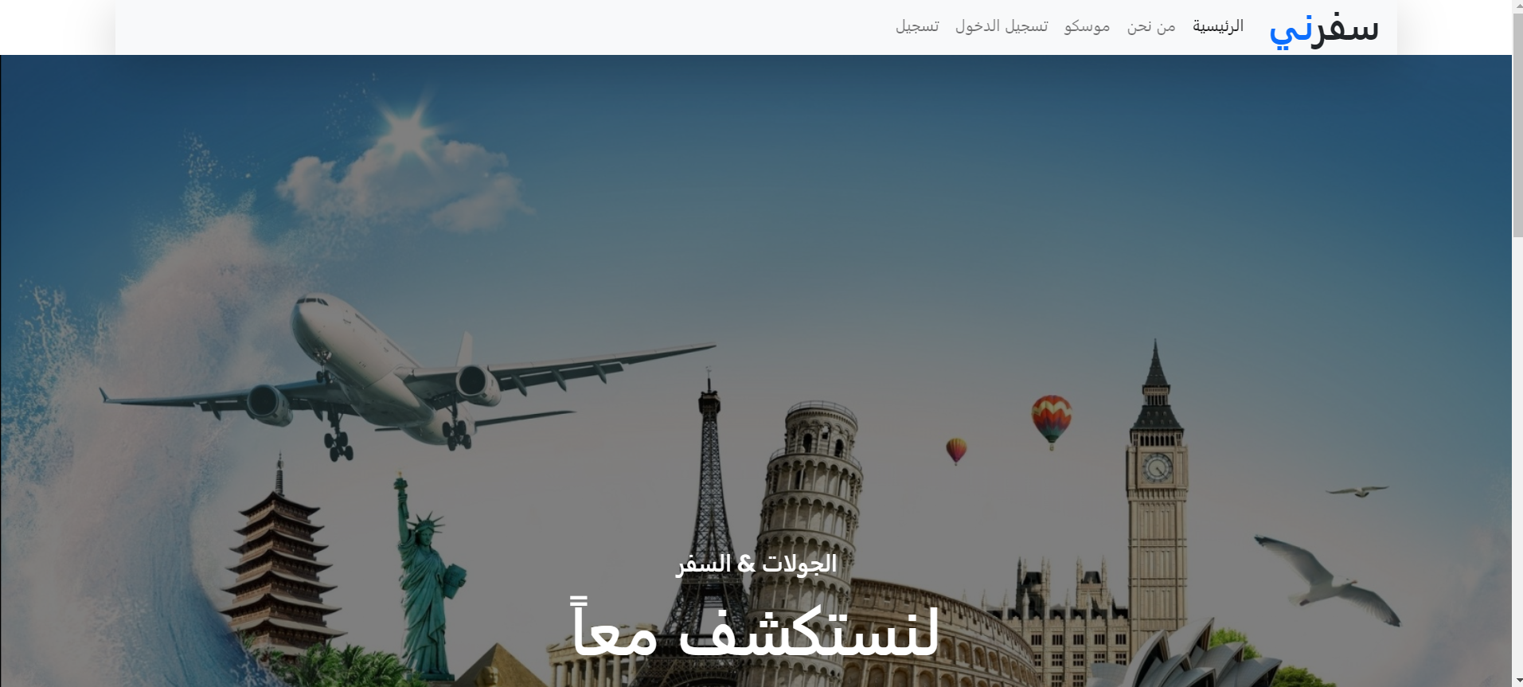
Home Pgae
The home page consist of slide show with a traveling photos and A small overview of the site

Slide 6
Home Pgae code
<script>
$(document).ready(function(){
$(".owl-carousel").owlCarousel({
items: 1,
loop : true,
margin:5,
rtl: true,
autoplay:true,
autoplayTimeout:3000,
autoplayHoverPause:true
});
});
</script>
Owl Carousel library
items: 1: Specifies that only one item should be visible at a time.
loop: true: Enables the carousel to loop continuously.
margin: 5: Sets a 5-pixel margin between carousel items.
rtl: true: Enables right-to-left mode, which is useful for languages that are written from right to left.
autoplay: true: Starts the carousel autoplay feature.
autoplayTimeout: 3000: Specifies the timeout between automatic transitions (in this case, 3000 milliseconds or 3 seconds).
autoplayHoverPause: true: Pauses the autoplay when the user hovers over the carousel.

Slide 7

02
About us
Motivation and about safirni

Slide 8
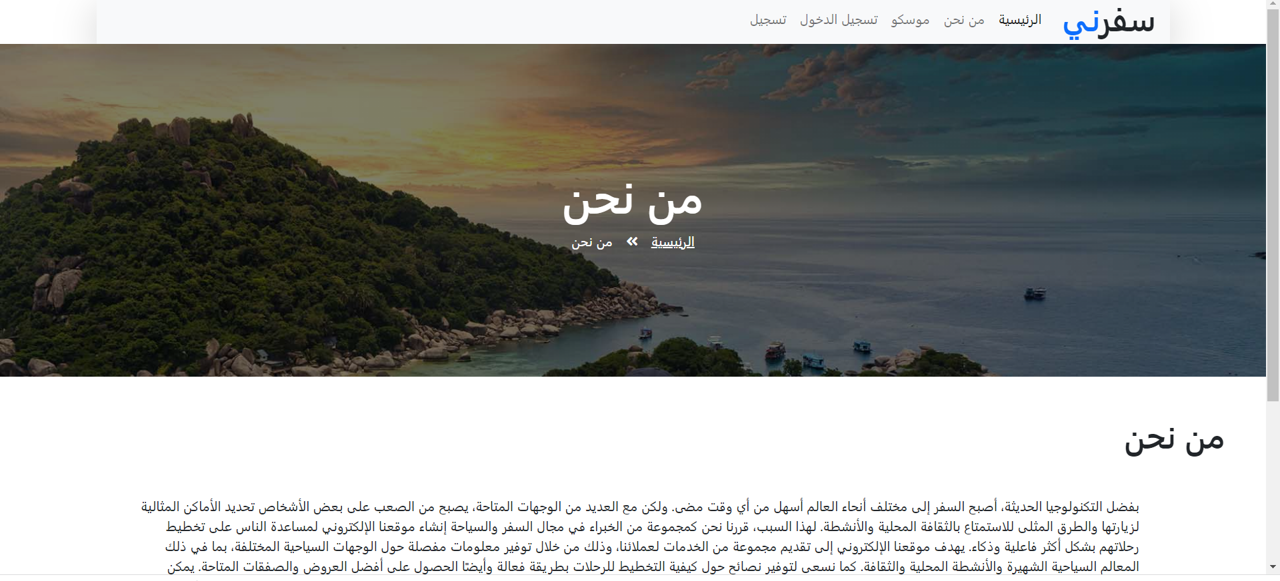
About us
The motivation and what is the goals and who we are

Slide 9
About us code
<div style="height: 70vh;">
<h1 class="w-80 m-auto p-5"> من نحن </h1>
<p class="w-80 m-auto h-auto" style="width: 80%;"> بفضل التكنولوجيا الحديثة، أصبح السفر إلى مختلف أنحاء العالم أسهل من أي وقت مضى. ولكن مع العديد من الوجهات المتاحة، يصبح من الصعب على بعض الأشخاص تحديد الأماكن المثالية لزيارتها والطرق المثلى للاستمتاع بالثقافة المحلية والأنشطة. لهذا السبب، ….سياحية مخصصة لتلبية احتياجاتهم الفردية وتفضيلاتهم، بما في ذلك ترتيب الرحلات الجوية والحجوزات في الفنادق والأنشطة والمزيد. كما نقدم أيضًا دليلنا الشامل للمدن والوجهات المختلفة، والذي يحتوي على معلومات حول أفضل المطاعم والأماكن التي يمكن زيارتها والتسوق والمزيد.</p>
</div>
This code is for the about us page where we describe the website

Slide 10
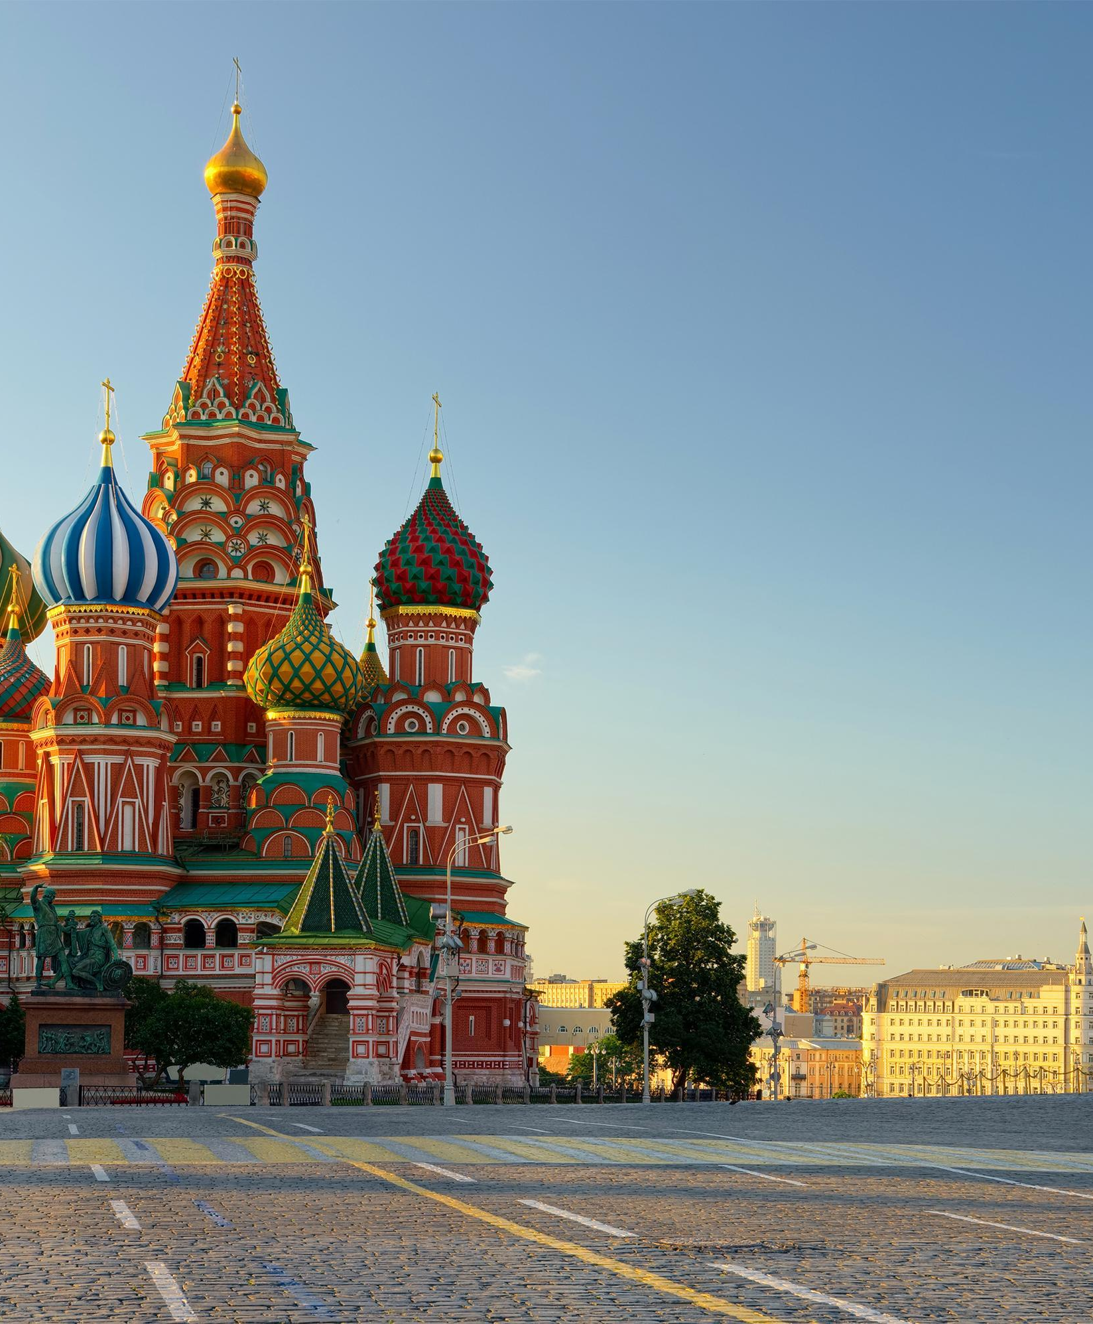
O3
Countries
We took for example Russia / Moscow

Slide 11
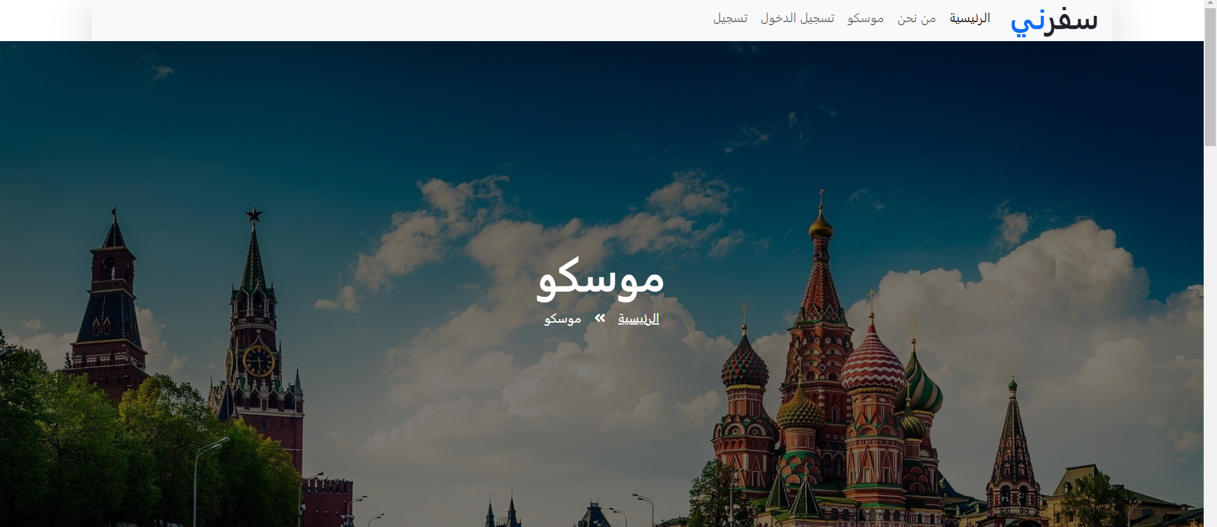
Moscow
Here’s the home page of the city and some pics of the most important culture

Slide 12
Moscow
<div class="container pt-5">
<div class="row">
<div class="col-lg-6 " style="min-height: 500px;">
<div class="position-relative h-100">
<img class="position-absolute w-100 h-100" src="img/kra.jpg" style="object-fit: cover;">
</div>
</div>
Paragraph on the left of the photo
This snip of code describe how the shape of the countries are photo of one of important places in the city and a plan how to visit it from a – z
In the second day the text will be on the right of the photo and so on , as you will see below

Slide 13
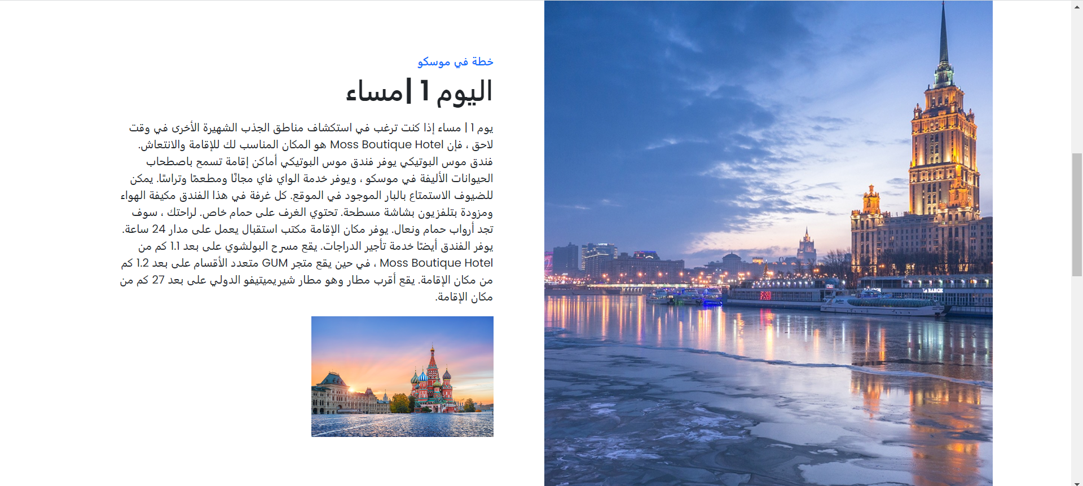
First day plan
Now here’s the plan for the first day contains which hotels are the best and where to go and eat a full plan for the first day

Slide 14
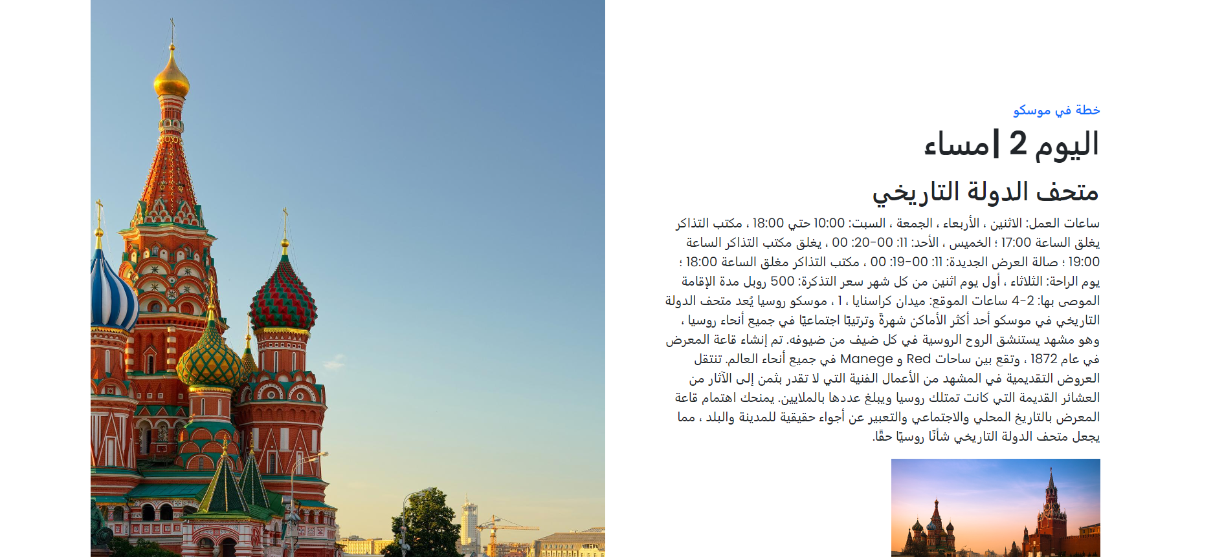
Second day plan
This is the second day of the plan to maximum benefit

Slide 15
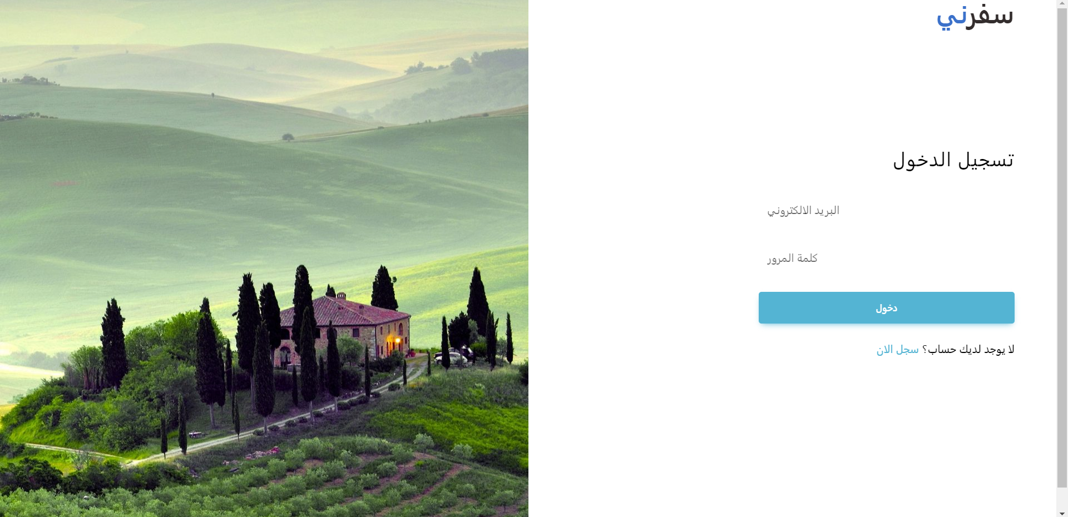
Login
The system ask you to enter your email and password to login as a member of Safirni .
This page well animated

Slide 16
Login
<form action="home.html" style="width: 23rem;" >
<h3 class="fw-normal mb-3 pb-3" style="letter-spacing: 1px;">تسجيل الدخول</h3>
<div class="form-outline mb-4">
<input type="email" class="form-control form-control-lg" />
<label class="form-label" >البريد الالكتروني</label>
</div>
<div class="form-outline mb-4">
<input type="password" class="form-control form-control-lg" />
<label class="form-label" >كلمة المرور</label>
</div>
<div class="pt-1 mb-4">
<button class="btn btn-info btn-lg btn-block" type="submit">دخول</button>
</div>
<p>لا يوجد لديك حساب؟ <a href="register.html" class="link-info">سجل الان</a></p>
</form>
This form show’s what a login should contain

Slide 17
Login
@keyframes bounce-in-bottom{0%{transform:translateY(500px);animation-timing-function:ease-in;opacity:0}38%{transform:translateY(0);
animation-timing-function:ease-out;opacity:1}55%{transform:translateY(65px);animation-timing-function:ease-in}72%{transform:translateY(0);
animation-timing-function:ease-out}81%{transform:translateY(28px);animation-timing-function:ease-in}90%{transform:translateY(0);
animation-timing-function:ease-out}95%{transform:translateY(8px);animation-timing-function:ease-in}100%{transform:translateY(0);
animation-timing-function:ease-out}}
.bounce-in-bottom{animation:bounce-in-bottom 1s both}
This code responsible of the animation I used anmaite.css library to animate the elements

Slide 18
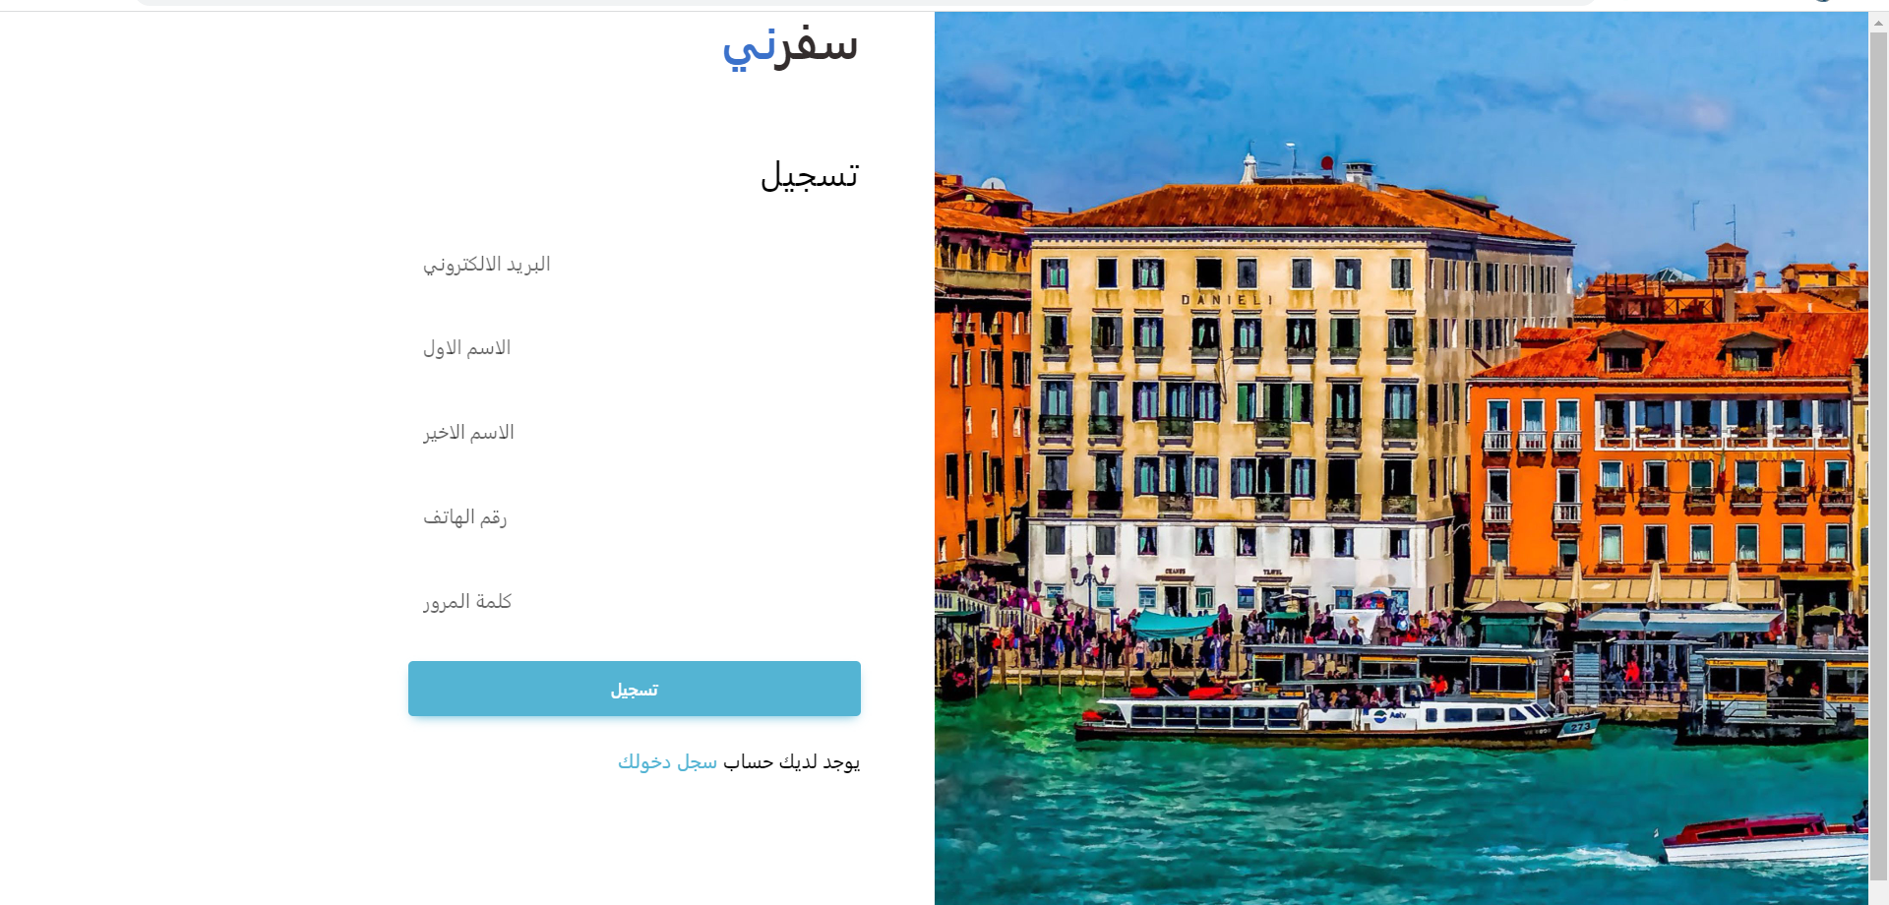
Registration
The system ask the user to enter the email , first name , second name , phone number and password to be a member of safirni
This page well animated

Slide 19
Registration
This code responsible of the animation I used anmaite.css library to animate the elements
@keyframes roll-in-left{0%{transform:translateX(-800px) rotate(-540deg);opacity:0}100%{transform:translateX(0) rotate(0deg);opacity:1}}
.roll-in-left{animation:roll-in-left 1s ease-out both}

Slide 20
Registration
<form style="width: 23rem;" action="login.html">
<h3 class="fw-normal mb-3 pb-3" style="letter-spacing: 1px;">تسجيل </h3>
<div class="form-outline mb-4">
<input type="email" class="form-control form-control-lg" />
<label class="form-label" >البريد الالكتروني</label>
</div>
<div class="form-outline mb-4">
<input type="text" class="form-control form-control-lg" />
<label class="form-label" > الاسم الاول</label>
</div>
This form show’s what a Registration should contain

Slide 21
Libraries used and tech
Techs used : 1-HTML
2-CSS
3-JavaScript
Libraries used : 1- bootstrap
2-owl
3-font-awesome
4- MDB
5- animate.css

